Slide 1


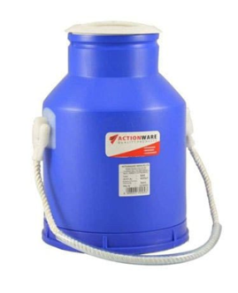
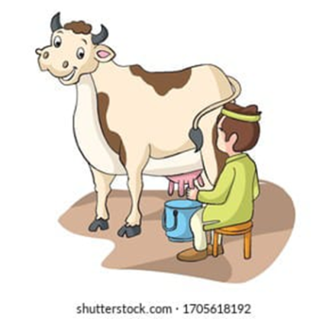
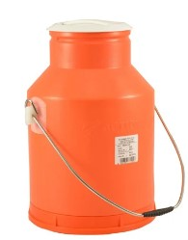
VISVESVARAYA TECHNOLOGICAL UNIVERSITY
GOVERNMENT ENGINEERING COLLEGE, RAMANAGARA
COMPUTER SCIENCE & ENGINEERING
PROJECT [21CSP76] – REVIEW 1
IOT-BASED MILK QUALITY ANALYZER &
PRESERVATION SYSTEM
Team Members :
Chithrashree P [1GG21CS008]
Rakshitha S [1GG21CS040]
Sanjana [1GG21CS042]
Megha Ashok Naik [1GG22CS403]
Guided By :
Mrs. Harsharani K S
Coordinated By :
Dr. Shabeen Taj G A

Slide 2

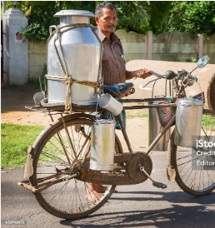
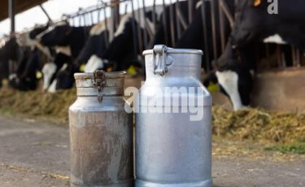
Introduction
An IoT-based Smart Milk Analyzer & Preservation System helps monitor milk quality automatically. Sensors are placed in milk containers to measure things like temperature, freshness, and fat content.
This data is sent to a system where machine learning analyzes it to check for spoilage, contamination, or other quality issues.
This technology is useful for dairy farms and milk distributors to ensure milk stays fresh, reduce waste, and improve safety, all without needing constant human checks.

Slide 3
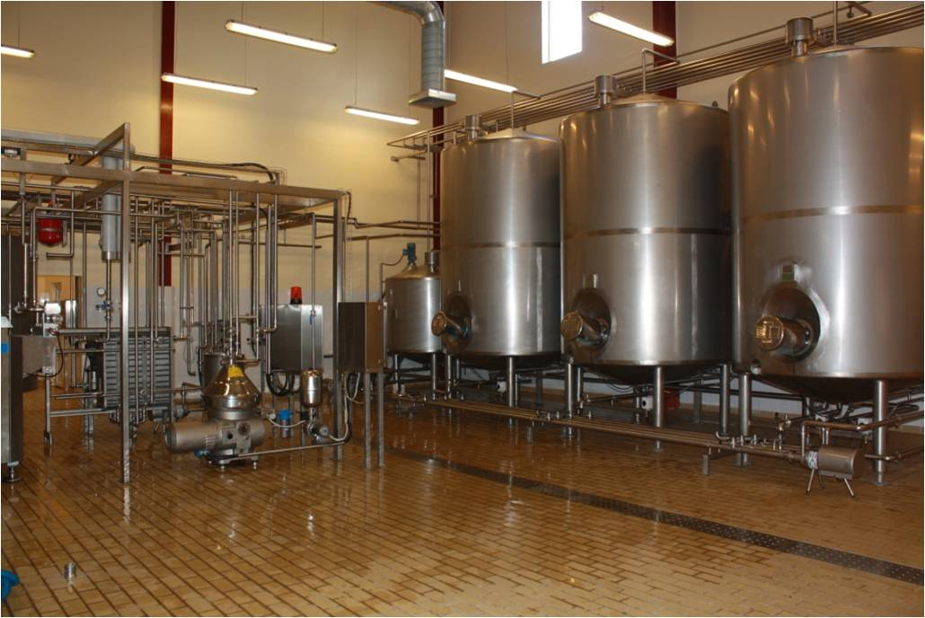
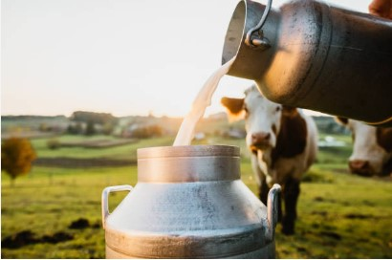
Problem statement
In small scale milk quality analysis is not developed . In large scale, already the setup is existed but it is costly and the components not available for every milkmen and Dairymen.
To overcome these problems we can use our model which is the solution for both problem, we can implement it for small scale with the minimal cost for analyze milk quality.
The challenge is to develop an automated system that uses IoT sensors and machine learning to continuously monitor and analyze milk quality in real-time, ensuring early detection of spoilage, contamination, and adulteration. And also maintain a constant Temperature to preserve milk .

Slide 4
LITERATURE REVIEW
PUBLICATION | TITLE | AUTHOR | METHODOLOGY | LIMITATIONS
International Research Journal of Modernaztion In Engg. Tech & Science [2024] | Smart Milk Quality Analysis & Grading | S.B. Dighe, Utkarsha Kailas, Bonde Snehadip Girip, Verma Snehika | Integrates with cutting-edge sensor technology, gives solutions | Refining the system's accuracy
JETIR Organization [2023] | IoT-Based Detection of Adulteration in Milk | Kilari Jyothi, Vakacharla Vijaya Lalitha,Adari Hima Chandu,Pachakula Nookaraju , Satharu Malla Reddy | Finds the milk Adulteration using Arduino Uno controller and sensors. Blynk application for upload the data . | More complex to detect accuracy in real time
Department of Agroindustrial Technology IPB University [2022] | An analysis and design of fresh milk smart grading system based on IoT | W. Habsari, F. Udin, Y. Arkeman | ANN, K-means clustering, Selection of key features | Difficult to implement, issues with accuracy of data

Slide 5
LITERATURE REVIEW
PUBLICATION | TITLE | AUTHOR | METHODOLOGY | LIMITATIONS
Association for Agriculture Environment and Biotechnology [2021] | Arduino-Based Milk Quality Monitoring System | Sumithra Goswami, Ashok Dangi | Detecting Milk quality parameters using Arduino-Uno controllers and sensors | Lack of automated feedback
International Journal of Pure and Applied Mathematics [2018] | IoT Based Milk Monitoring System for Detection of Milk Adulteration | Dr.G.Rajkumar, Dr.T.Ananth Kumar, Dr. T.S.Arun Samuel, Dr. E.Muthu Kumaran | Arduino-Uno, LM35 temperature sensor, shows the different aspects of milk | Time-consuming for going and setting up the system

Slide 6


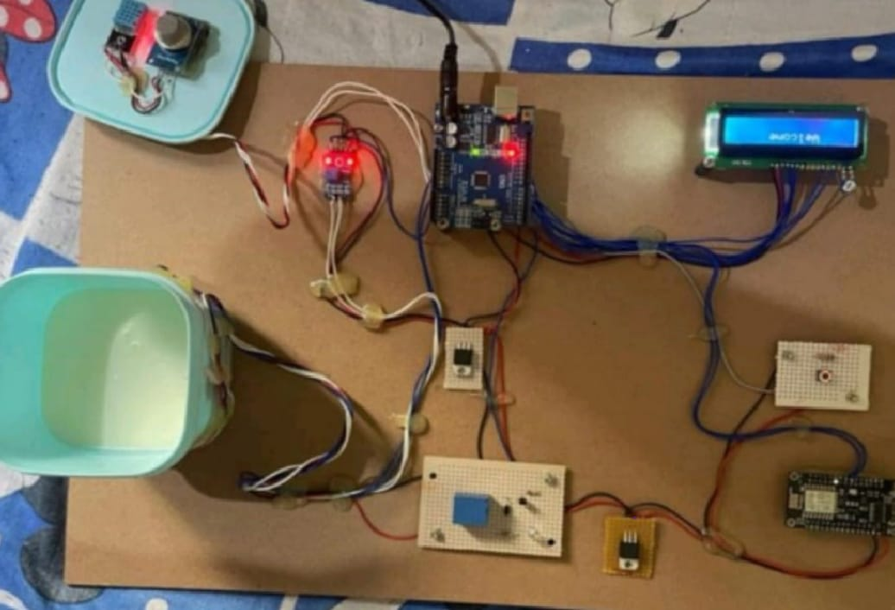
EXISTING SYSTEM
In the current system, milk quality is often manually monitored with no automated way to maintain constant temperature or analyze milk freshness based on pH or color.
There is no real-time alert system for temperature fluctuations, leading to potential spoilage.

Slide 7
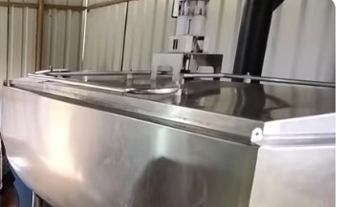
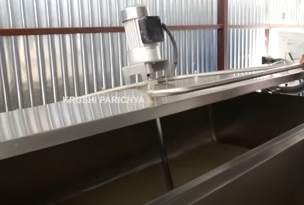
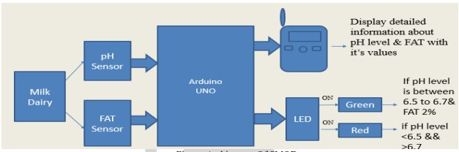
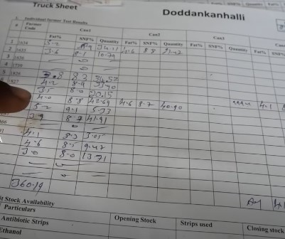
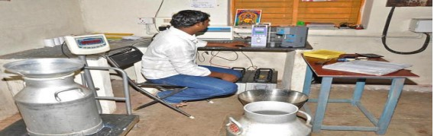
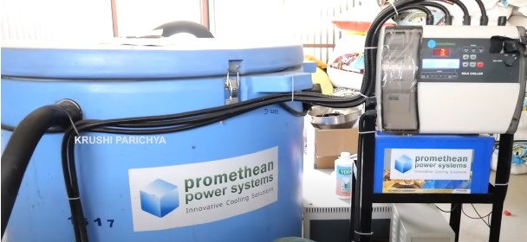
EXISTING SYSTEM

Slide 8
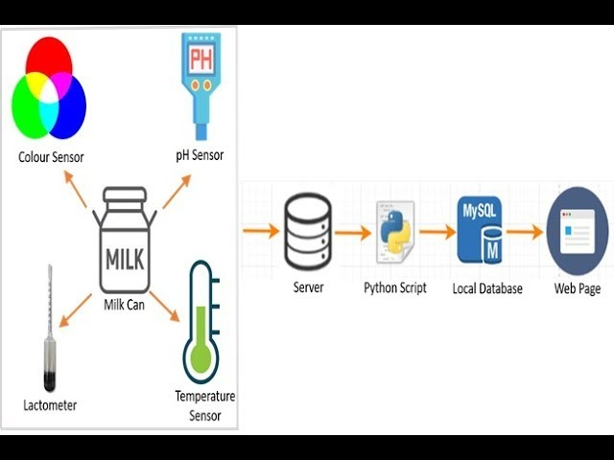
PROPOSED SYSTEM
The proposed system uses pH, temperature, and color sensors integrated with Node MCU to automatically classify milk quality and maintain a constant temperature.
Any deviations trigger real-time alerts via a web interface, ensuring immediate corrective action to prevent spoilage.

Slide 9
SYSTEM REQUIREMNTS
SOFTWARE REQUIREMENTS
Web Application
Html
CSS
JavaScript
ML-Python : KNN
Arduino IDE
C++
Milk Quality Dataset
HARDWARE REQUIREMENTS
NodeMCU ESP32
pH sensor
Temperature sensor
Color sensor
Ultrasonic Sensor
Power supply

Slide 10
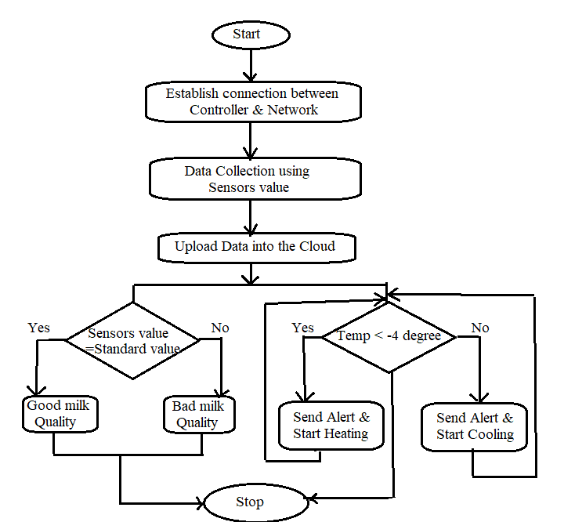
DESIGN FLOW DIAGRAM

Slide 11
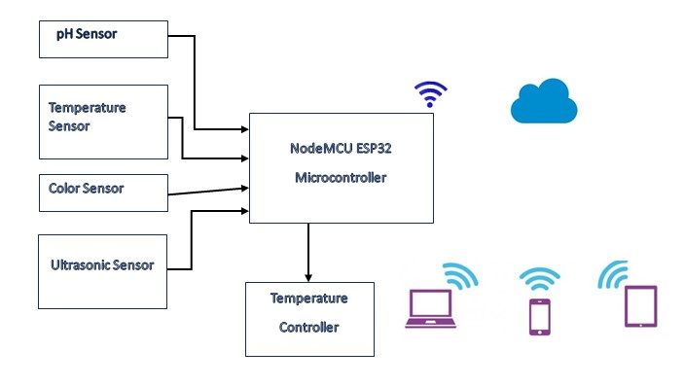


BLOCK DIAGRAM
CLOUD STORAGE

Slide 12
REFERENCES
JETIR March 2023-IOT BASED DETECTION OF ADULTERATION IN MILK Kilari Jyothi,Vakacharla Vijaya Lalitha,Adari Hima Chandu, Pachakula Nookaraju ,Satharu Malla Reddy
International Research Journal of Modernization in Engineering Technology and Science(April-2024) SMART MILK QUALITY ANALYSIS & GRADING Prof. S. B. Dighe, Bad Utkarsha Kailas, Gorde Snehal Dilip,Varma Shrutika Sanjay
Milk Quality Prediction Using Machine Learning Drashti Bhavsar, Yash Jobanputra, Nirmal Keshari Swain, Debabrata Swain( 29 November 2023)
Department of Agroindustrial Technology IPB University[2022],An analysis and design of fresh milk smart grading system based on IoT. W. Habsari, F. Udin,Y. Arkeman
https://youtu.be/ua-m2gV9tME?si=y4WDsg6Vtxc55cQj
https://youtu.be/lCF6la-Wnks?si=58hsKHpM1JbMfjoD
https://youtu.be/bxmF6d-gbU8?si=xMgvGkGI47qt8I5a

Slide 13
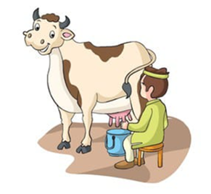
.
.
THANK YOU

